Slide 1
Important Trends Resulting in Varying Work Patterns on Middle-aged Adults
Changes in the global economy have produced job instability, forcing middle-age workers to acquire new trades and skills to better adapt to changing job skill requirements.
Today, many other midlife adults are working well into their 60s or early 70s. The decision to retire is drive by both health and financial status (i.e. availability of pension benefits) (Han & Moen, 1999 et al.). Many people now “phase” into retirement.
Workers with high levels of educational attainment prior to middle adulthood are more likely than their less educated peers to retrain in middle adulthood (Luo, 2009).
Greater job mobility
Retirement
Variability
Increasing
Education
Re-entry

Slide 2
What about your friends??: The Social Life
Mid-life adults usually have a friendship circle that consists of 4-7 people they would actually considered to be “friends”.
It has been suggested that midlife adults have less time than other adult age groups for friendships (Antonucci et al., 2001). Do u think this may be due to the “sandwich generation” concept?
Contributing factors to overall well-being:
-Affection
-Companionship
-Understanding
-Social support

Slide 3
Gender Differences in Friendships during Middle Adulthood
MEN
WOMEN
Following marriage, tend to have less female friends and begin to depend solely upon their wives as their female confidant.
Adequate social supports suggest positive physical health between ages 50 and 70.
After the career begins, time for friends decreases
Usually maintain lifelong friendships longer than women.
More expressive, and personally oriented in friendships
Those who reported having close groups of female friends have reported greater well-being than midlife women without such interpersonal resources.
After childbearing, time for friends decreases
More easily to make new friends than men

Slide 4
Let’s Talk About Sex Baby! Are Middle-Aged Adults Really As Boring As We Think They Are??
Most common stereotypes about middle-aged adults in relation to sexual intercourse:
-they’re not as attractive anymore
-they’re not as interested in the opposite sex as they used to be
-they do not have a sexual desire.
ALL WRONG!!
In fact, Landau et al. (2007) reported than many middle-aged adults are very sexually active, with more than 75% of men ages 57-85 acknowledging themselves as “very well endowed”, while more than 50% of middle-aged women. Nonetheless, it was found that women still needed a sense of commitment, while men still considered intercourse as just “sex”, even at middle- age.

Slide 5
Intimacy Issues? Maybe not…
As age increases, people usually have less intimate contact or sexual intercourse with their partner; however in middle adulthood “four-play” becomes widely accepted. Surprising?
Four play includes, but is not limited to:
-Caressing
-Physical closeness with a partner
-Masturbation
-Fantasy
It is during this stage in life that sexual satisfaction is based off of intimacy just as much as it is based off physical health.
http://www.youtube.com/watch?v=xIrX4TIZl2M

Slide 6
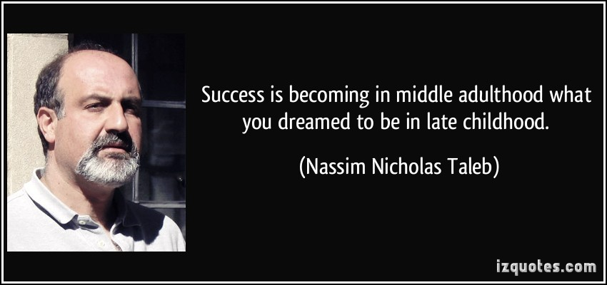
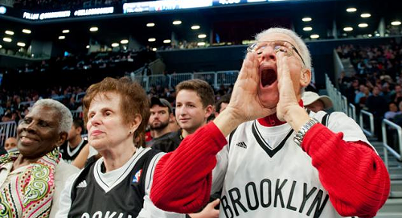
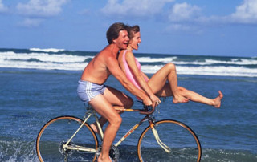
Hope You Enjoyed Our Journey Through Middle Adulthood and Learned A Little Along the Way!

