Slide 1
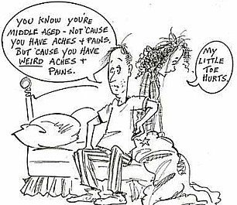
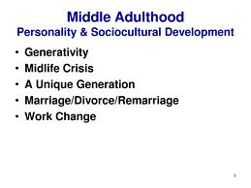
Middle Adulthood
The Sandwich Generation
Alysha Alimohamed
Wynter Bryant
Suwilanji Kuezi-Nke
Ken Miki
Janetta Serano
Marcus Terry
Shelby Zimmer

Slide 2
What is “Middle Adulthood”? When does it begin?
Different views from researchers
Ages 40-64 or 30-70
What is Middle Adulthood?
Central or midlife
Different views from researchers
Either chronological or developmental
Is Middle Adulthood about gains and loses?
Achieving goals
Unmet goals
Psychological changes
Cognitive changes
Biological changes
Social changes

Slide 3
So you want to know the 3 main theories on Middle Adulthood….
Generativity vs. Stagnation (Erik Erikson)
Finding Balance (Carl Jung & Daniel Levinson)
Life-Span theory and the Gain-Loss Balance

Slide 4
Generativity vs. Stagnation: Erik Erikson Generativity is the ability to channel personal interests to provide care, concern and guidance for both younger and older generations while leaving a legacy.
Meaning? They want to feel a sense of purpose – a way to help and guide younger generations based off of their own interests and strengths.
“Erikson saw generativity as an instinct that works to perpetuate society.” (Hutchinson, 2011) - paraphrase
Productivity at this stage is measured by their contributions to their family and society as a whole.
Without finding a way to connect and contribute to future generations, adults in this age span become self-absorbed and therefore feel stagnant.
http://www.youtube.com/watch?v=XBMOIvBXa68

Slide 5
Challenges to Erikson’s work…
Recent research suggests that people are living longer due to further education and better healthcare so Erikson’s Generativity vs. Stagnation theory may apply to older adults.
John Kotre (1995) argues that there are different types of generativity including: communal generativity, and agentic generativity, and cultural generativity.

Slide 6
Finding Balance: Carl Jung
Searching for our true self after repressing our identity to conform to society’s norms
Gender identities and roles diminish
Balance between introversion and extroversion
Introvert: more comfortable with the inner world of thoughts and feelings. View the world as how it affects them.
Extrovert: more comfortable with the world of objects and other people. More concerned with their impact in the world.

Slide 7
Finding Balance: Daniel Levinson
Levinson had a part in coining the idea of the mid-life crisis.
As cited in Hutchinson (2011), Levinson asserted that during the transition into middle adulthood, individuals attempt to give greater attention to previously neglected components.
Levinson frames this as trying to balance four opposing aspects of identity:
Young vs. old
Creating vs. destruction
Feminine vs. masculine
Attachment vs. separation

Slide 8
Gain-Loss Balance
Evidence of gains in self-esteem and emotional maturity
Losses in biological functioning
These gains and losses are subjective: they are given meaning and worth based off of cultural context and values
Gains and losses are shaped by group-based and individual-based attributes

Slide 9
Biological Changes and Physical and Mental Health in Middle Adulthood
Despite dramatic increase in numbers of adults in the last few decades, between the ages of 45-60 some physical and mental decline begins to occur.
Changes="aging process" stem from interactions of biology with the following factors:
-psychological
-sociocultural
-spiritual
Biggest changes for biology, physical/mental health:
-physical appearance
-changes in mobility
-reproductive system
-beginnings of chronic disease

Slide 10
Wow…you’re turning into a completely different person!
Changes in Physical Appearance
Changes in Mobility
Skin: wrinkles, loss of firmness/elasticity, dryness, spotty localized pigmentation
Hair: thins/grays on head, appears in unwanted areas-ears, eyebrow clumps, facial hair on women.
Build: loss of height, gains in weight starting in 40's, half inch height loss per decade-loss of bone material in vertebrae
By 40s losses in muscle, bones, joints = mobility loss, by 45 = strength loss.
Max bone density reached early adulthood, loss of bone material occurs following max period
Joints/cartilage- obvious changes start in 40s

Slide 11
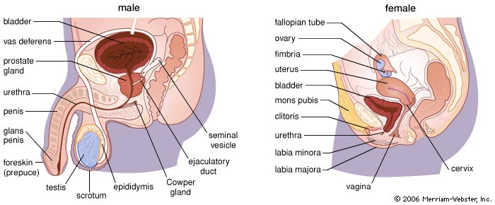
Changes in the Reproductive System
Middle adulthood: women's ability to conceive/bear children
declines until cessation
Menopause: permanent end to menstruation, medically defined as 12 consecutive months. Median age = 50, 51. 90% of U.S women experience between 45 and 55.
This change is not obvious.
Lowered sperm counts starting in 40s and 50s, testes shrink due reduction in volume of seminal fluid after age 60.
At this stage both men and women begin to experience decreased sexual functioning; yet, many couples manage to maintain healthy sex lives.

Slide 12
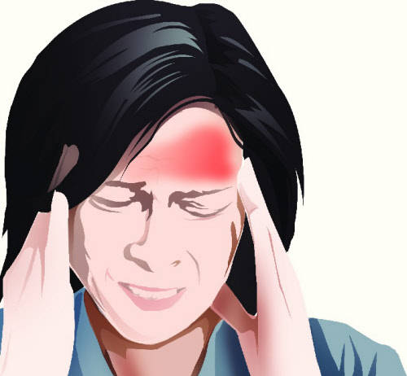
Feeling a Little Tense? Maybe it’s Chronic Stress!
Cortisol is known as the ‘stress hormone’ that gets released in stressful situations to give you a surge of energy to react when you need to (such as moving fast if you’re about to be hit by a car). However, it becomes unhealthy (and may contribute to aging, according to the new study) when long-term stress signals the body to keep releasing cortisol and wears down your body.
BUT WAIT THERE IS HOPE!!!!
The good news is that there are a number of simple lifestyle tricks that can help you slash your cortisol levels. For example, earlier research found that subjects who practiced Buddhist meditation significantly decreased both cortisol and blood pressure in a 6-week Thai study. Similarly, participants who meditated daily for 4 months decreased the hormone by an average of 20% in a study at Maharishi University, while levels in the non-meditating control group actually went up slightly.

Slide 13
Health is Highly Variable Amongst Middle-Aged Adults
The highest death rates are amongst African-American males.
Fatal accidents and cold and allergies tend to decline.

Slide 14
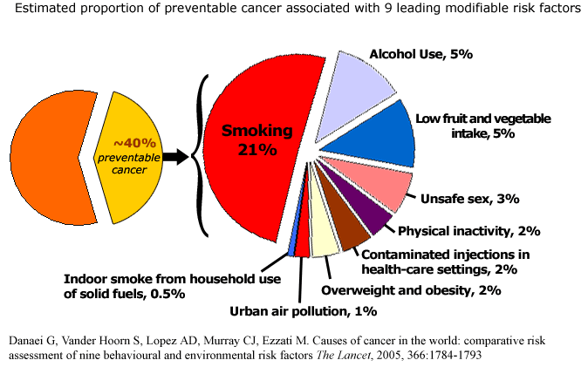
Feeling a little “under the weather”? Chronic conditions and illness
Persistent Symptoms
Functional disabilities began to arise
Chronic conditions increase with each passing decade from middle adulthood on. Chronic conditions often lead to the following problems:
Slow process that likely leads to disability before death
Is major cause of death in middle and high income countries
Stress will cause illness to rapidly increase

Slide 16
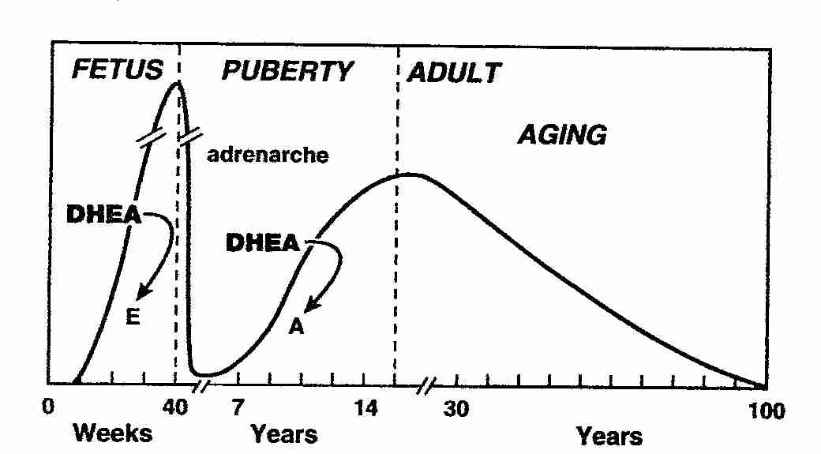
Dehydroepiandrosterone (DHEA)
Secretory products of Adrenal Glands
Convertible into androgens and estrogen
Based on the abundance during the frequent diseases of aging
Used in the U.S. and other countries as nutritional supplement for anti aging & metabolic support

Slide 17
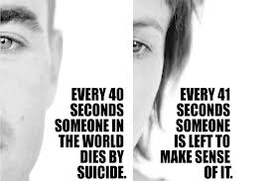
Bringing it All Together
-Mental Health
-Suicide
-Substance Abuse
http://www.huffingtonpost.com/2013/05/02/suicide-rate-rises-middle-aged_n_3203936.html

Slide 18
Mental Health: Why Am I Feeling this Way? Depression is the most common mental health disorder amongst middle-age adults

