Slide 1
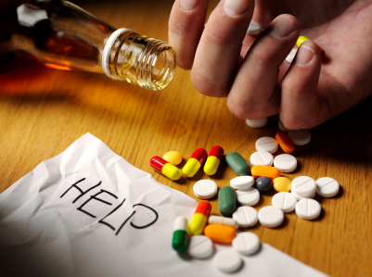
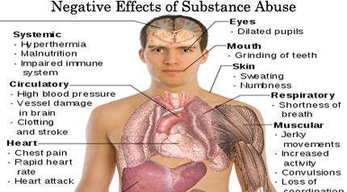
Substance Abuse
Alcohol and illicit drugs
Marijuana
Tobacco
Prescription drugs

Slide 2
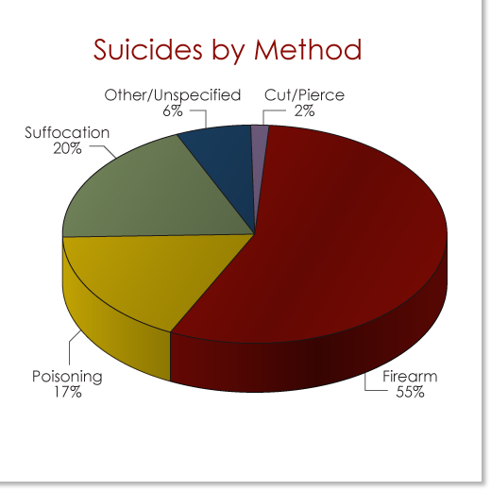
Suicide
Adults age 35-64
Greatest amount among people aged 50-54
White(40%) , American Indian and Alaska Natives (65%)
Increased 23% or more across U.S.
Firearm and hanging/suffocation (middle aged men)
Poising and firearm most common(middle aged women)

Slide 3
What’s Really Going On?: Are you freaking out too?!
Ways to combat a Midlife Crisis
-Adaptive Strategies
-Resilience
-Reframing

Slide 4
Intellectual Changes
Do cognitive skills decline in middle age?
Risk factors
Protective factors
Gender differences

