Slide 1
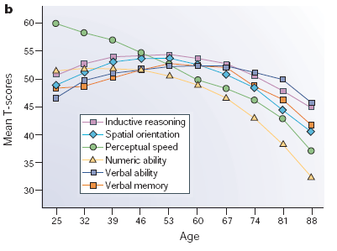
Seattle Longitudinal Study
Measures six skills over time:
Vocabulary
Verbal memory
Number
Spatial orientation
Inductive Reasoning
Perceptual Speed

Slide 2
Gains in the Middle Aged Brain
Bilateralization and neuroplasticity
Emotional Regulation
Decision Making

Slide 3
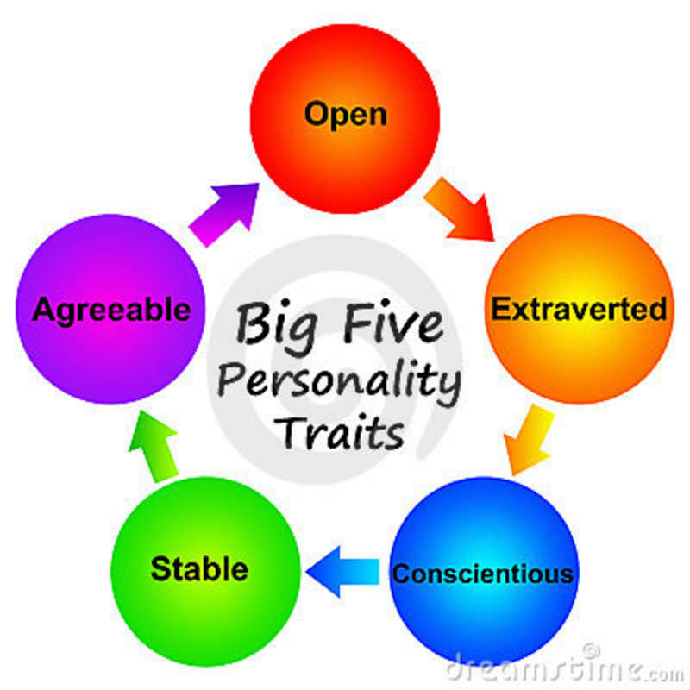
Personality Change vs. Stability
Theories Supporting Stability:
Theories Supporting Change:
Freud
The Trait Theory
Caspi’s Contextual Model
Jung
Erikson
Vaillant

Slide 4
The Trait Theory
The “Big Five” Personality Traits
Neuroticism
Extroversion
Conscientiousness
Agreeableness
Openness to Change

