Slide 1
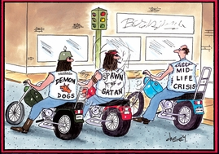
The Midlife Crisis?

Slide 2
Whitbourne’s Identity Process Model
Assimilative identity style
Accomodative identity style
Balanced identity style

Slide 3
Stuck in the Middle: Sandwich Generation Demographics
The primary caregivers in the sandwich generation are women.
Greatest worries of the sandwich generation are finances and their care recipients’ health issues.
43% of sandwich generation Asians and 26% of whites have college degrees. As compared to 20% of sandwich generation African Americans and 16% sandwich generation Hispanics.
13% of Asians and 17% of whites earn $75,00 or more, while only 7% of African Americans and 8% of Hispanics fall into this category of income.
Amongst all Americans between the ages of 44 and 55 3 out of every f4 whites, nearly 3 out of every 4 Hispanics, and 4 out of 5 Asians are married.
Blacks are far less likely to be married, at least a ¼ are divorced or separated; 1 in 5 blacks has never married.
http://www.youtube.com/watch?v=YhXrHD7qWDk

Slide 4
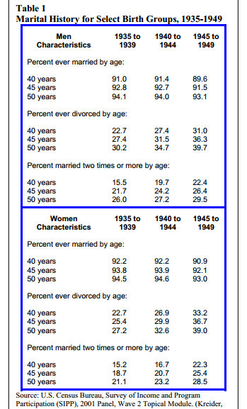
Feeling Single??: Divorce Rates!
Divorce is increasingly becoming a normative life event for individuals age 45-64
Social processes associated with population aging, which refers to both an increasing proportion of older adults and longer life expectancies, are transforming marital dynamics and familial relationships for older adults throughout most advanced industrial societies.
An estimated 39% of women and 39.7% of men born between 1945 and 1949 had been divorced by the time they reached age 50.
Reports from the Census Bureau indicate that approximately one quarter (26.2%) of divorcing men in a given year are between the ages of 45-64. A lower, but substantial percent of divorcing women (18.9%) are in the same age range.
An estimated 28.5% of women and 29.5% of men born between 1945 and 1949 had remarried at least once by the age of 50.
In fact, Census data indicates 31.2% of men and 28.4% of women between the ages of 50 to 59 have been remarried at least once. For adults between the ages of 40-49 and 60-69, the percentages in remarriages are slightly lower. Still, more than one-in-five en and women in these age ranges have divorced and remarried
http://www.today.com/video/today/48110424#48110424

Slide 5
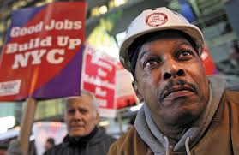
The Working Class
Employment is an important role for midlife adults in many parts of the world, for men and women alike (Dittmann-Kohli, 2005; Kin & Moen, 2001).
Affluent middle-aged adults have shown a continuous decline in the average age of retirement, particularly among men (Kim & Moen, 2001; Moen, 2004).
Researchers suggest that this trend in early retirement may be due to healthier and better education amongst the midlife cohort in comparison to previous generations.
Research indicates that loss of work in middle adulthood is a very critical life event that has negative consequences for emotional well-being (Dittman-Kohli, 2005).

